Slide 1


SQL CAPSTONE PROJECT
Priyanka-S10205

Slide 2


INTRODUCTION
The major aim of this project is to gain insight into the sales data of Amazon to understand the different factors that affect sales of the different branches.

Slide 3

DATASET OVERVIEW
This dataset contains sales transactions from three different branches of Amazon, respectively located in Mandalay, Yangon and Naypyitaw. The data contains 17 columns and 1000 rows

Slide 4

METHODOLOGY
Steps Taken:
Data Wrangling
Feature Engineering
Insights
Tools Used:
MYSQL Workbench
CSV Files

Slide 5
DATA WRANGLING
Create a table:
CREATE TABLE IF NOT EXISTS amazon(
Invoice_ID VARCHAR(50),
Branch VARCHAR(50),
City VARCHAR(50),
Customer VARCHAR(50),
Gender VARCHAR(10),
Product_line VARCHAR(50),
Unit_price DECIMAL(10,2),
Quantity INT,
Tax_5_percent DECIMAL(10,4),
Total DECIMAL(10,4),
Date DATE,
Time TIME,
Payment VARCHAR(50),
cogs DECIMAL(10,2),
gross_margin_percent DECIMAL(10,9),
gross_income DECIMAL(10,4),
Rating DECIMAL(3,1)
);
Build a database:
CREATE DATABASE IF NOT EXISTS amazon;
Import data from CSV:
Import data from csv file to MYSQL Workbench.

Slide 6
FEATURE ENGINEERING
Add a new column named timeofday to give insight of sales in the Morning, Afternoon and Evening.
ALTER TABLE amazon ADD COLUMN timeofday VARCHAR(50);
UPDATE amazon SET timeofday =
CASE WHEN Time BETWEEN '00:00:00' AND '12:00:00' THEN 'Morning'
WHEN Time BETWEEN '12:01:00' AND '16:00:00' THEN 'Afternoon'
ELSE 'Evening'
END;
Add a new column named dayname that contains the extracted days of the week on which the given transaction took place (Mon, Tue, Wed, Thur, Fri).
ALTER TABLE amazon ADD COLUMN dayname VARCHAR(10);
UPDATE amazon SET dayname = DAYNAME(Date);
Add a new column named monthname that contains the extracted months of the year on which the given transaction took place (Jan, Feb, Mar).
ALTER TABLE amazon ADD COLUMN monthname VARCHAR(10);
UPDATE amazon SET monthname = MONTHNAME(Date);

Slide 7
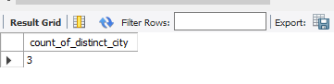
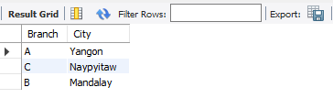
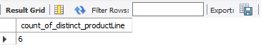
ANALYSIS
1.What is the count of distinct cities in the dataset?
SELECT COUNT(DISTINCT City) AS count_of_distinct_city
FROM amazon;
2.For each branch, what is the corresponding city?
SELECT DISTINCT Branch, City
FROM amazon;
3.What is the count of distinct product lines in the dataset?
SELECT COUNT(DISTINCT Product_line) AS count_of_distinct_productLine
FROM amazon;

Slide 8
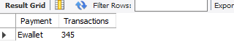
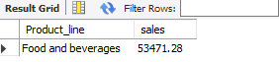
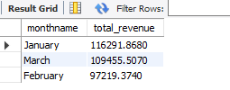
ANALYSIS
4.Which payment method occurs most frequently?
SELECT Payment, COUNT(Invoice_ID) AS Transactions
FROM amazon
GROUP BY Payment
ORDER BY Transactions DESC LIMIT 1;
5.Which product line has the highest sales?
SELECT Product_line,SUM(Quantity * Unit_price) AS sales
FROM amazon
GROUP BY Product_line
ORDER BY sales DESC LIMIT 1;
6.How much revenue is generated each month?
SELECT monthname,SUM(Total) AS total_revenue
FROM amazon
GROUP BY monthname;

Slide 9
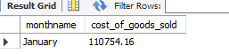
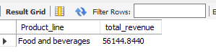
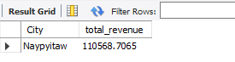
ANALYSIS
7.In which month did the cost of goods sold reach its peak?
SELECT monthname,SUM(cogs) AS cost_of_goods_sold
FROM amazon
GROUP BY monthname
ORDER BY cost_of_goods_sold DESC LIMIT 1;
8.Which product line generated the highest revenue?
SELECT Product_line,SUM(Total) AS total_revenue
FROM amazon
GROUP BY Product_line
ORDER BY total_revenue DESC LIMIT 1;
9.In which city was the highest revenue recorded?
SELECT City,SUM(Total) AS total_revenue
FROM amazon
GROUP BY City
ORDER BY total_revenue DESC LIMIT 1;

Slide 10
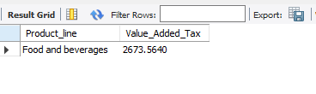
ANALYSIS
10.Which product line incurred the highest Value Added Tax?
SELECT Product_line,SUM(Tax_5_percent) AS Value_Added_Tax
FROM amazon
GROUP BY Product_line
ORDER BY Value_Added_Tax DESC LIMIT 1;

Slide 11
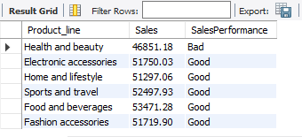
ANALYSIS
11.For each product line, add a column indicating "Good" if its sales are above average, otherwise "Bad."
WITH ProductSales AS (
SELECT Product_line, SUM(Quantity * Unit_price) AS Sales
FROM amazon
GROUP BY Product_line
),
AverageSales AS (
SELECT AVG(Sales) AS Avg_Sales
FROM ProductSales
)
SELECT P.Product_line,P.Sales, CASE
WHEN P.Sales > (SELECT Avg_Sales FROM AverageSales) THEN 'Good'
ELSE 'Bad'
END AS SalesPerformance
FROM ProductSales P;

Slide 12
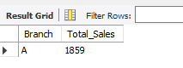
ANALYSIS
12.Identify the branch that exceeded the average number of products sold.
WITH BranchTotalSales AS(
SELECT Branch,SUM(Quantity) AS Total_Sales
FROM amazon
GROUP BY Branch
),
AverageProductsSold AS(
SELECT AVG(Total_Sales) AS Avg_Sales
FROM BranchTotalSales
)
SELECT B.Branch,B.Total_Sales
FROM BranchTotalSales B
WHERE B.Total_Sales > (SELECT Avg_Sales FROM AverageProductsSold);

Slide 13
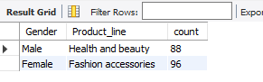
ANALYSIS
13.Which product line is most frequently associated with each gender?
WITH ProductLineGender AS(
SELECT Gender,Product_line,COUNT(Gender) AS count
FROM amazon
GROUP BY Gender,Product_line
),
MaxCountGender AS(
SELECT Gender,MAX(count) AS MaxCount
FROM ProductLineGender
GROUP BY Gender
)
SELECT ProductLineGender.Gender, ProductLineGender.Product_line, ProductLineGender.count
FROM ProductLineGender
JOIN MaxCountGender ON ProductLineGender.Gender = MaxCountGender.Gender
AND ProductLineGender.count = MaxCountGender.MaxCount;

Slide 14
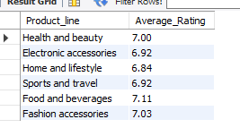
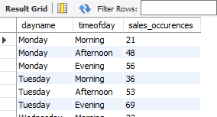
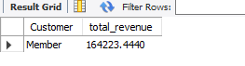
ANALYSIS
14.Calculate the average rating for each product line.
SELECT Product_line, ROUND(AVG(Rating), 2) AS Average_Rating
FROM amazon
GROUP BY Product_line;
15.Count the sales occurrences for each time of day on every weekday.
SELECT dayname,timeofday,COUNT(*) AS sales_occurences
FROM amazon
GROUP BY dayname,timeofday
ORDER BY FIELD(dayname,'Monday','Tuesday','Wednesday','Thursday','Friday','Saturday','Sunday'),
FIELD(timeofday,'Morning','Afternoon','Evening');
16.Identify the customer type contributing the highest revenue.
SELECT Customer,SUM(Total) AS total_revenue
FROM amazon
GROUP BY Customer
ORDER BY total_revenue DESC LIMIT 1;

Slide 15
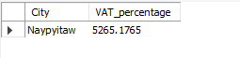
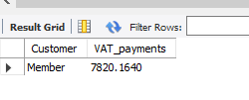
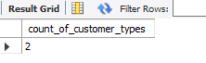
ANALYSIS
17.Determine the city with the highest VAT percentage.
SELECT City,SUM(Tax_5_percent) AS VAT_percentage
FROM amazon
GROUP BY City
ORDER BY VAT_percentage DESC LIMIT 1;
18.Identify the customer type with the highest VAT payments.
SELECT Customer,SUM(Tax_5_percent) AS VAT_payments
FROM amazon
GROUP BY Customer
ORDER BY VAT_payments DESC LIMIT 1;
19.What is the count of distinct customer types in the dataset?
SELECT COUNT(DISTINCT Customer) AS count_of_customer_types
FROM amazon;

Slide 16
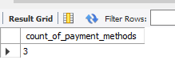
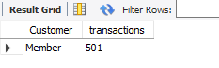
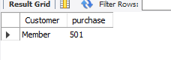
ANALYSIS
20.What is the count of distinct payment methods in the dataset?
SELECT COUNT(DISTINCT Payment) AS count_of_payment_methods
FROM amazon;
21.Which customer type occurs most frequently?
SELECT Customer,COUNT(Invoice_ID) AS transactions
FROM amazon
GROUP BY Customer
ORDER BY transactions DESC LIMIT 1;
22.Identify the customer type with the highest purchase frequency.
SELECT Customer,COUNT(Quantity) AS purchase
FROM amazon
GROUP BY Customer
ORDER BY purchase DESC LIMIT 1;

Slide 17
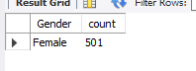
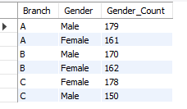
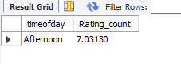
ANALYSIS
23.Determine the predominant gender among customers.
SELECT Gender,COUNT(*) AS count
FROM amazon
GROUP BY Gender
ORDER BY count DESC LIMIT 1;
24.Examine the distribution of genders within each branch.
SELECT Branch,Gender,COUNT(*) AS Gender_Count
FROM amazon
GROUP BY Branch,Gender
ORDER BY Branch,Gender_Count DESC;
25.Identify the time of day when customers provide the most ratings.
SELECT timeofday,AVG(Rating) AS Rating_count
FROM amazon
GROUP BY timeofday
ORDER BY Rating_count DESC LIMIT 1;

Slide 18
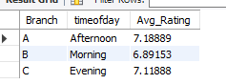
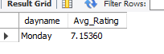
ANALYSIS
26.Determine the time of day with the highest customer ratings for each branch.
WITH Ratings AS(
SELECT Branch,timeofday,AVG(Rating) AS Avg_Rating
FROM amazon
GROUP BY Branch,timeofday
)
SELECT Branch,timeofday,Avg_Rating
FROM Ratings
WHERE (Branch,Avg_Rating) IN (
SELECT Branch,MAX(Avg_Rating)
FROM Ratings
GROUP BY Branch
)
ORDER BY Branch;
27.Identify the day of the week with the highest average ratings.
SELECT dayname,AVG(Rating) AS Avg_Rating
FROM amazon
GROUP BY dayname
ORDER BY Avg_Rating DESC LIMIT 1;

Slide 19
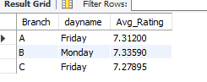
ANALYSIS
28.Determine the day of the week with the highest average ratings for each branch.
WITH Ratings AS(
SELECT Branch,dayname,AVG(Rating) AS Avg_Rating
FROM amazon
GROUP BY Branch,dayname
)
SELECT Branch,dayname,Avg_Rating
FROM Ratings
WHERE (Branch,Avg_Rating) IN (
SELECT Branch,MAX(Avg_Rating)
FROM Ratings
GROUP BY Branch
)
ORDER BY Branch;

Slide 20

PRODUCT ANALYSIS:
ANALYSIS HIGHLIGHTS
There are 6 unique product lines.
Food and beverages product line has the highest sales.
Health and beauty product line is most frequently associated with male and Fashion accessories product line is most frequently associated with female
SALES ANALYSIS:
In January, cost of goods sold reaches peak.
Naypyitaw city was the highest revenue recorded.
Member customer type is contributing the highest revenue.
CUSTOMER ANALYSIS:
There are 2 customer types which are member and normal.
Member customer occurs most frequently.
Female gender is the predominant gender among customers.
Afternoon time customers provide most ratings.
On Monday customers give highest average ratings.

Slide 21

CONCLUSION
In this data analysis project, we embarked on a journey to gain valuable insights from Amazon’s sales data. We began by preparing and exploring the dataset, cleaning any missing or null values, and engineering new features to help us uncover meaningful patterns.
We addressed a variety of questions, ranging from understanding product performance and sales trends to diving into customer behavior.
Throughout our analysis, we made use of SQL queries to extract relevant information from the dataset.
Some key takeaways from our analysis include:
Identification of top-performing product lines and branches.
Analysis of sales trends, which can inform sales strategies and modifications.
Profiling of customer segments and their profitability.

Slide 22
THANK YOU!
FOR YOUR ATTENTION

